Slide 1
Application for electronic payment system in universities

Slide 2
INTRODUCTION OF THIS PROJECT:
The objective of our project is to develop a GUI (Graphical User Interface) based software i.e. platform independent & user friendly and which can be fit into any college system. It will remove data redundancy and will be fast in operation.
The main problems with the present college fee management
software’s are:
Platform dependency.
Data redundancy problems.
Slow in execution.
Do not cover all the modules that should be present in the college fee management software.
Threat to security levels.
Improper beginner tutorials.

Slide 3
Our software will overcome all these problems faced by any college management software. Though college management software is actually custom based, as it is developed for meeting the requirements of a particular college but we have created the project as a global one which can satisfy the needs of all college systems.

Slide 4
PRESENT WORKING SYSTEM :
No online web page where the accounts of the students are created during their admission.
Student can’t pay the fee directly through online payment system.
The user should not provide information which is registered or given by the institution during his/her admission.
There is no predefined classification of fee categories which give a brief view about payment.
This existing system is not providing secure registration and profile management of all the users properly.
The system doesn’t provide any facility to maintain any feedback option for users.
Having all information in the form of paper records it is not in secure and time taken process to get data immediately.
Student Fee Payments data searching process is not there. It is not user friendly.
Existing system is total manual process. It is time taken process.

Slide 5
TO BE PROPOSED :
The development of this new system contains the following activities, which try to automate the entire process keeping in the view of database integration approach.
To create an online web page where the accounts of the students are created during their admission through this account.
Students of a particular institution can pay the fee directly through online payment system and can pay the fee either by transferring the amount from their personal account or they can use their credit card or by their bank account details.
Through this one can pay the fee at any place at any time through payers can save their time. There is no need to address the college for payment which can also be done by mobile phone.
The user should provide information which is registered or given by the institution during his/her admission. Every student is provided with a confidential account and password in which all the details regarding his fee due are displayed and updated as per the fee payment.
They can receive alerts about the payment and online receipt forms on payment of the fee.

Slide 6
There is a predefined classification of fee categories which give a brief view about payment.
They can pay even extra fees such as ppt fees, trainings etc. Different groups and subgroups regarding the fields in which the fee is being processed is been provided in this web page or student account.
This mainly includes the fields such as college fee, jntu fee, bus fee and other training programs that are included and the fee details of those programs are mentioned in their particular accounts.
This is very secured transactions through which parents can avoid long time distance.
They are provided with information related about the payment dates, amount of money paid etc., It also gives information about fee dues and the respective last dates. The alerts are sent to their mobiles every month so that they can be reminded.
Authentication is provided for this application only registered users can access.Report generation features is provided using to generate different kind of reports.

Slide 7
USERS OF THE SYSTEM:
Administrator
College Admin Staff
Student

Slide 8
MODULES OF THE SYSTEM
Administrator
Fee Payments
Mails Related To Due payments
Registration and Authentication
Reports

Slide 9
FUNCTIONAL REQUIREMENTS OF THE PROJECT:
Administrator:
Branches:
Department
Add New Department Details
View Department Details
Course
Add New Course Details
View Course Details
Braches
Add New Branch Details
View Branch Details

Slide 10
FEE PAYMENTS:
Academic Fee
Training &Placement Fee
Exam Fee
Laboratory Fee
Hostel Fee
Transportation Fee

Slide 11
MAILS RELATED TO DUE PAYMENTS.
Mails
Sent Mails
View Mails
Delete Mails

Slide 12
ACCOUNT CREATION (OR) REGISTRATION AUTHENTICATION:
Search:
Students:
View Branch Wise Students
Staff:
View Staff
Security:
Login
Logout
Registration
Change Passwords
Forget Password
View Profiles
Update Profiles

Slide 13
REPORTS
Generating Different Format Fee Reports to be download (.xls)

Slide 14
SOFTWARE REQUIREMENTS
Operating System : Windows XP/2003 or Linux
User Interface : HTML, CSS
Client-side Scripting : JavaScript
Programming Language : Java (Servlets, jsp, jdbc)
IDE/Workbench : My Eclipse 6.0
Database : Oracle 10g
Server Deployment : Tomcat 6.x

Slide 15
HARDWARE REQUIREMENTS
Processor : Pentium IV
Hard Disk : 40GB
RAM : 1GB or more

Slide 16
SYSTEM REQUIREMENT SPECIFICATION

Slide 17
Overview of the project
Users of the System :
Administrator
College Admin Staff
Student
Modules of the System
Administrator
Fee Payments
Mails Related To Due payments
Registration and Authentication
Reports

Slide 18
Functional Requirements of the Project:
1. Administrator:
Branches:
Department
Add New Department Details
View Department Details
Course
Add New Course Details
View Course Details
Braches
Add New Branch Details
View Branch Details

Slide 19
2. Fee Payments:
Academic Fee
Training &Placement Fee
Exam Fee
Laboratory Fee
Hostel Fee
Transportation Fee
3. Mails Related to Due payments.
Mails
Sent Mails
View Mails
Delete Mails

Slide 20
4. Account Creation (or) Registration Authentication:
Search:
Students:
View Branch Wise Students
Staff:
View Staff
Security:
Login
Logout
Registration
Change Passwords
Forget Password
View Profiles
Update Profiles

Slide 21
5. Reports
* Generating Different Format Fee Reports to be download (.xls)
Authentication and Security Module
The user details should be verified against the details in the user tables and if it is valid user, they should be entered into the system. Once entered, based on the user type access to the different modules to be enabled / disabled and individual user can change their default password or old password.
Admin Module
This module consists of the following sub modules:
Registration Module
Here admin can register new faculty, student and store their details in database.
Colleges Management Module
Here admin can access any user related information. User can be a faculty or student.

Slide 22
Query And Feedback Module:
In this module a user can send a query and respective user can reply it. And depending on reply user can give feedback.
Students Module:
In this Module the Students can view their Fee information and they can send queries to admin branch regarding their fee schedule.

Slide 23
FEASIBILITY REPORT

Slide 24
TECHNICAL FEASIBILITY:
Evaluating the technical feasibility is the trickiest part of a feasibility study. This is because, at this point in time, not too many detailed design of the system, making it difficult to access issues like performance, costs on (on account of the kind of technology to be deployed) etc. A number of issues have to be considered while doing a technical analysis.
Understand the different technologies involved in the proposed system
Find out whether the organization currently possesses the required technologies
OPERATIONAL FEASIBILITY:
Proposed projects are beneficial only if they can be turned into information systems that will meet the organizations operating requirements. Simply stated, this test of feasibility asks if the system will work when it is developed and installed.
ECONOMIC FEASIBILITY:
Economic feasibility attempts 2 weigh the costs of developing and implementing a new system, against the benefits that would accrue from having the new system in place. This feasibility study gives the top management the economic justification for the new system.

Slide 25
SDLC METHODOLOGIES

Slide 26
This document play a vital role in the development of life cycle (SDLC) as it describes the complete requirement of the system. It means for use by developers and will be the basic during testing phase. Any changes made to the requirements in the future will have to go through formal change approval process.
SPIRAL MODEL was defined by Barry Boehm in his 1988 article, “A spiral Model of Software Development and Enhancement. This model was not the first model to discuss iterative development, but it was the first model to explain why the iteration models.
The steps for Spiral Model can be generalized as follows:
The new system requirements are defined in as much details as possible. This usually involves interviewing a number of users representing all the external or internal users and other aspects of the existing system.
A preliminary design is created for the new system.
A first prototype of the new system is constructed from the preliminary design. This is usually a scaled-down system, and represents an approximation of the characteristics of the final product.

Slide 27
A second prototype is evolved by a fourfold procedure:
Evaluating the first prototype in terms of its strengths, weakness, and risks.
Defining the requirements of the second prototype.
Planning an designing the second prototype.
Constructing and testing the second prototype.
Risk factors might involved development cost overruns, operating-cost miscalculation, or any other factor that could, in the customer’s judgment, result in a less-than-satisfactory final product.
The existing prototype is evaluated in the same manner as was the previous prototype, and if necessary, another prototype is developed from it according to the fourfold procedure outlined above.
The preceding steps are iterated until the customer is satisfied that the refined prototype represents the final product desired.
The final system is constructed, based on the refined prototype.
The final system is thoroughly evaluated and tested. Routine maintenance is carried on a continuing basis to prevent large scale failures and to minimize down time.

Slide 28
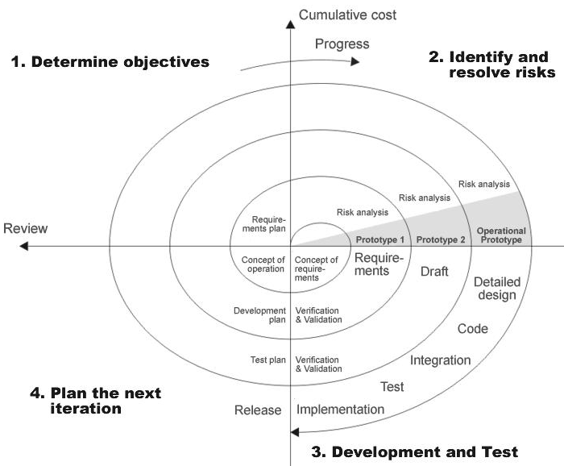
THE FOLLOWING DIAGRAM SHOWS HOW A SPIRAL MODEL ACTS LIKE:

Slide 29
ADVANTAGES OF SPIRAL MODEL:
Estimates(i.e. budget, schedule etc .) become more realistic as work progresses, because important issues discovered earlier.
It is more able to cope with the changes that are software development generally entails.
Software engineers can get their hands in and start working on the core of a project earlier.

Slide 30
DATA FLOW DIAGRAMS

Slide 31
A graphical tool used to describe and analyze the moment of data through a system manual or automated including the process, stores of data, and delays in the system. Data Flow Diagrams are the central tool and the basis from which other components are developed. The transformation of data from input to output, through processes, may be described logically and independently of the physical components associated with the system. The DFD is also know as a data flow graph or a bubble chart.
The Basic Notation used to create a DFD’s are as follows:
Dataflow: Data move in a specific direction from an origin to a destination.
2. Process: People, procedures, or devices that use or produce (Transform) Data. The physical component is not identified.
3. Source: External sources or destination of data, which may be People, programs, organizations or other entities.
4. Data Store: Here data are stored or referenced by a process in the System.

Slide 32
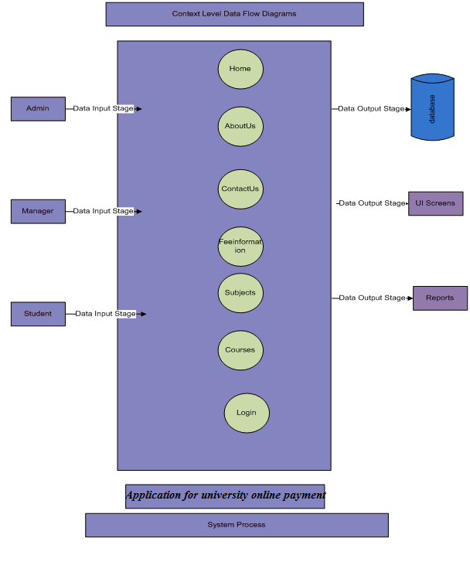
CONTEXT LEVEL DATA FLOW DIAGRAM

Slide 33
LEVEL 1 DATA FLOW DIAGRAM FOR ADMINISTRATOR:

Slide 34
LEVEL1 DATA FLOW DIAGRAM FOR MANAGER:

Slide 35
LEVEL1 DATA FLOW DIAGRAM FOR STUDNT:

Slide 36
AUTHENTICATION DATA FLOW DIAGRAM:

Slide 37
E-R DIAGRAM

Slide 38
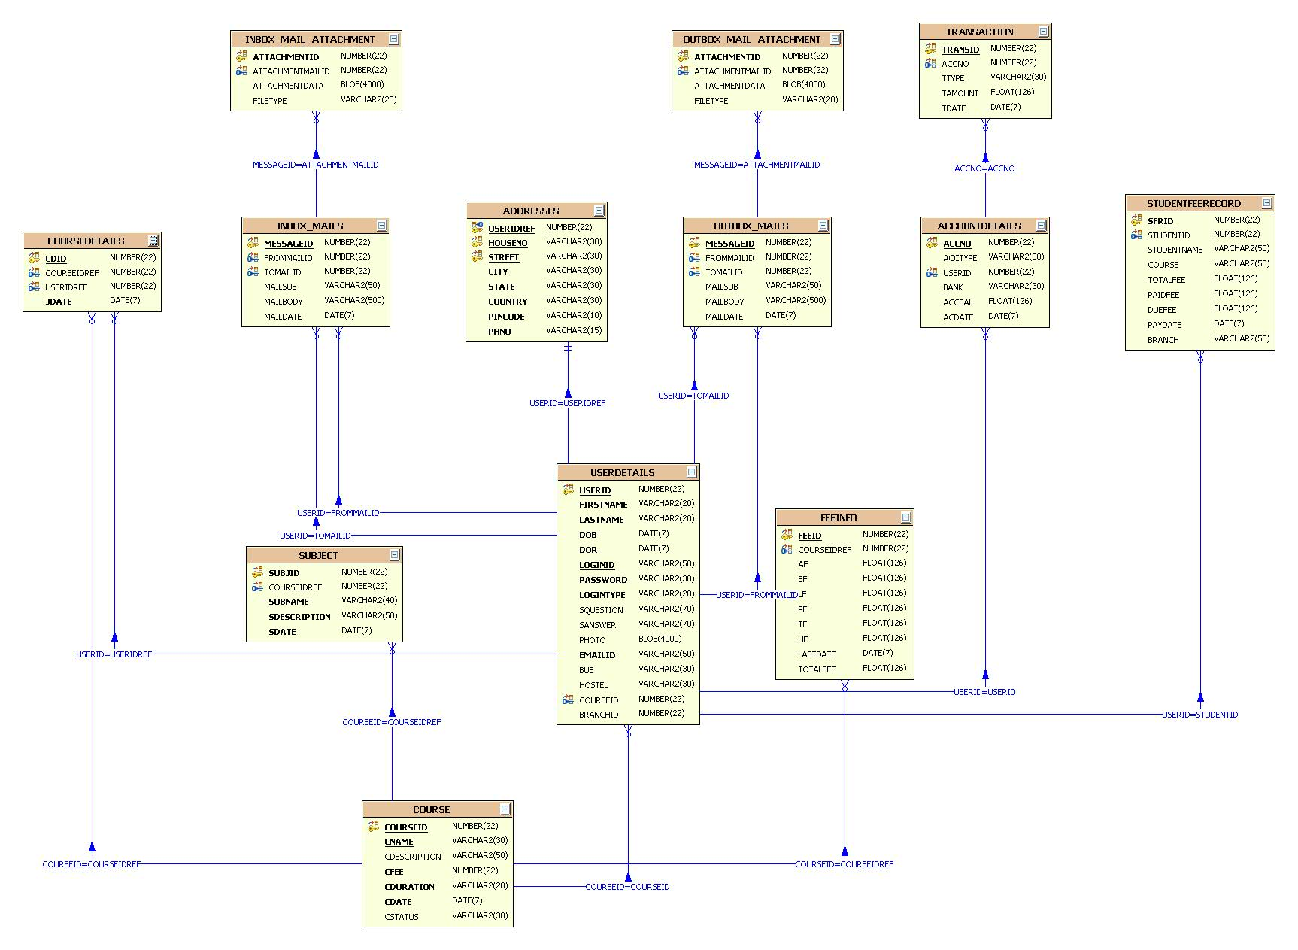

Slide 39
UML DIAGRAMS

Slide 40
UNIFIED MODELING LANGUAGE DIAGRAMS
The unified modeling language allows the software engineer to express an analysis model using the modeling notation that is governed by a set of syntactic semantic and pragmatic rules.
USER MODEL VIEW
This view represents the system from the users perspective.
The analysis representation describes a usage scenario from the end-users perspective.
STRUCTURAL MODEL VIEW
In this model the data and functionality are arrived from inside the system.
This model view models the static structures.
BEHAVIORAL MODEL VIEW
It represents the dynamic of behavioral as parts of the system, depicting the interactions of collection between various structural elements described in the user model and structural model view.
IMPLEMENTATION MODEL VIEW
In this the structural and behavioral as parts of the system are represented as they are to be built.
ENVIRONMENTAL MODEL VIEW
In this the structural and behavioral aspects of the environment in which the system is to be implemented are represented.

Slide 41
CLASS DIAGRAM
DateBase
+properties
+connection
+setProperties()
+getProperties()
+setConnection()
+getConnection()
RegistrationDAO
+jobProviderVO
SecurityDAO
AccountDao
+jobSeekerVO
+credentialVO
+category
+connection
+checkUser()
+userId()
+registerProvider(jobProderVO)
+login()
+accountInfo
+viewProvider()
+logout()
+depositcash()
+registerJobSeeker(jobSeekerVO)
+viewJobSeeker()

Slide 42
CLASS COLLABORATION DIAGRAMS

Slide 43
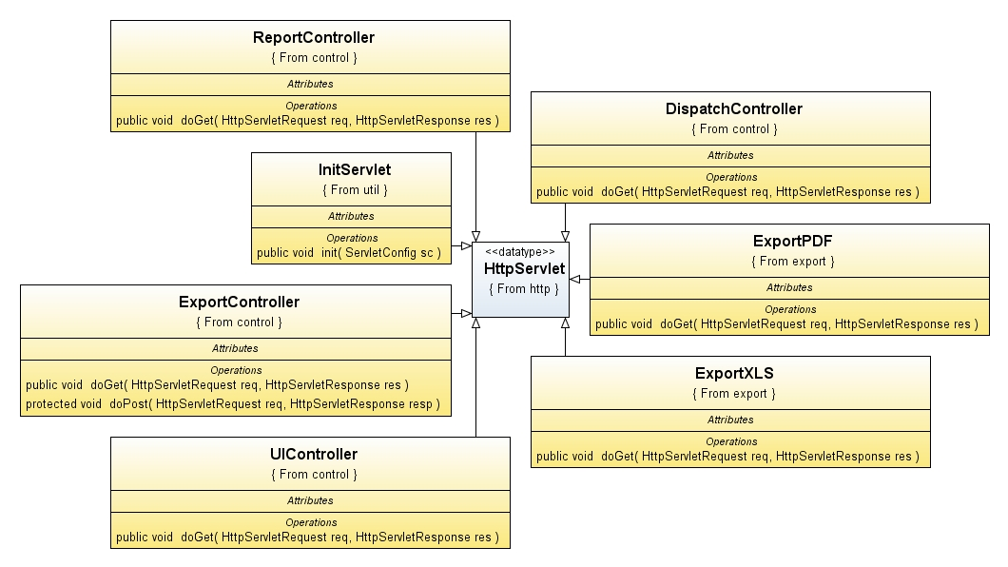

Slide 44
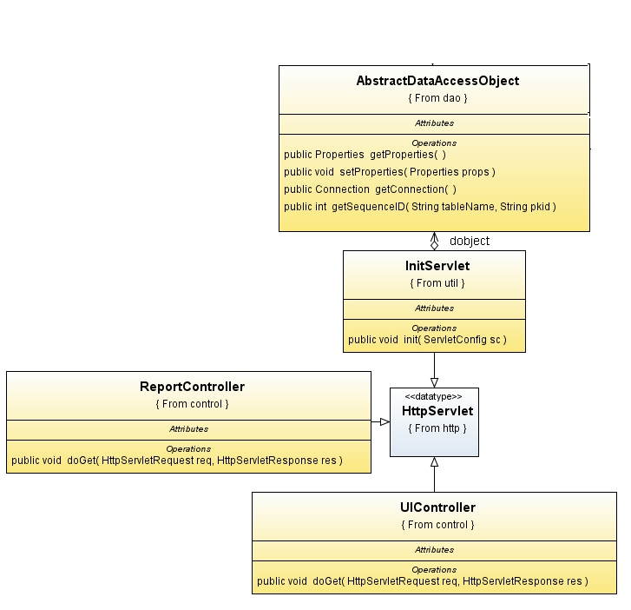

Slide 45
USE CASE DIAGRAMS

Slide 46
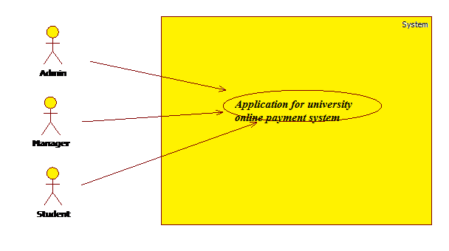
SYSTEM USE CASE DIAGRAM

Slide 47
ADMINISTRATOR USE CASE DIAGRAM

Slide 48
MANGER USE CASE DIAGRAM:
System
Home
Branch,course
View both
Student info
view student
Student fee info
Fee info
View bal
Account info
deposit
Manager
View feedback
mail compose
Mail Info
Securuty
view mails
Logout
change password

Slide 49
STUDENT USE CASE DIAGRAM

Slide 50
SEQUENCE DIAGRAMS

Slide 51
LOGIN SEQUENCE DIAGRAM

Slide 52
PRESENT LOGIN USER REPORT SEQUENCE DIAGRAM

Slide 53
ADMIN SEQUENCE DIAGRAM
Admin
Server
Home
Dept,brnch,course info
Account
Fee info
Employee,student
Mail
Logout
1 : logindetails()
2 : login success()
3 : loginfail()
4 : Add course,branch,dept()
5 : view bal,depost()
6 : add,view sudent fee()
7 : Registration()
8 : compose,sent,outbox()
9

Slide 54
MANAGER SEQUENCE DIAGRAM:
Managerr
Server
Home
Account info
Student details
Fee info
Mail,Queries,feedback
Security
Logout
1 : logindetails()
2 : login success()
3 : loginfail()
4 : view bal,deposit()
5 : view student details()
6 : student fee()
7 : mails,queries recive,solution,view feedback()
8 : changepassword()
9 : logout()

Slide 55
STUDENT SEQUENCE DIAGRAM:
Student
Server
Home
Dept info
FEE info
View profile
mail
Security
Logout
1 : logindetails()
2 : login success()
3 : loginfail()
4 : view course ,subject ()
5 : pay fee, view fee info()
6 : profile()
7 :compose,view()
8 : changepassword()
9 : logout()

Slide 56
COLLABORATION DIAGRAMS

Slide 57
LOGIN COLLABORATIVE DIAGRAM

Slide 58
PRESENT LOGIN USER REPORT COLLABORATIVE DIAGRAM

Slide 59
ADMIN COLLABORATION DIAGRAM:
Fee info
Employee,student
Mails
Account
Dept,branch,course info
6 : add,view student fee()
8 : compose,inbox,outbox()
7 : Registration()
4 : add course,branch,dept()
5 :View bal,deposit()
1 : logindetails()
Admin
Server
Home
2 : login success()
3 : loginfail()
9
Logout

Slide 60
MANAGER COLLABORATIVE DIAGRAM:
Student details
FEE info
Mails,queries,Feedback
Security
Account info
8 : changepassword()
5 : view student details()
6 : Student fee()
7 : view feedback,solution,mails()
4 :view bal,deposit()
Manager
1 : logindetails()
Server
Home
2 : login success()
9 : logout()
3 : loginfail()
Logout

Slide 61
STUDENT COLLABORATIVE DIAGRAM:
Fee
View profile
Security
Mail
Dept,course,subject info
8 : changepassword()
5 : pay fee,info()
6 : view profile()
7 : compose,outbox,inbox()
4 :view ()
Student
1 : logindetails()
Server
Home
2 : login success()
9 : logout()
3 : loginfail()
Logout

Slide 62
ACTIVITY DIAGRAMS

Slide 63
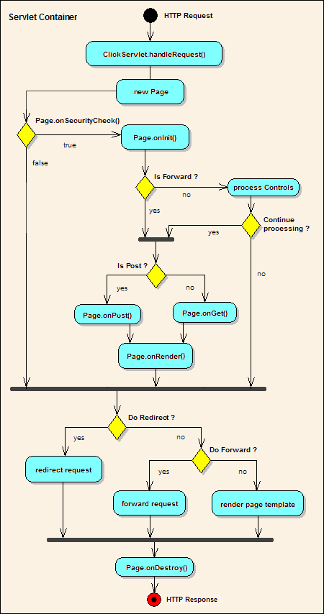
SERVLET CONTAINER

Slide 64
ADMIN ACTIVITY DIAGRAM:
Admin
login
loginfail
username & password
login success
Home
Add Dept,course,branch,
Account
Fee info
Employee,Student registration
Feedback
Mails
logout

Slide 65
MANAGER ACTIVITY DIAGRAM:
Manager
login
loginfail
username & password
login success
Home
View Branch,Course
Account info,fee info
Student detials
Query
Feedback
changePassword
logout

Slide 66
Student
login
loginfail
username & password
login success
Home
Dept,course,subject info
Fee info
View profile
Mail
Security
View student fee
logout

Slide 67
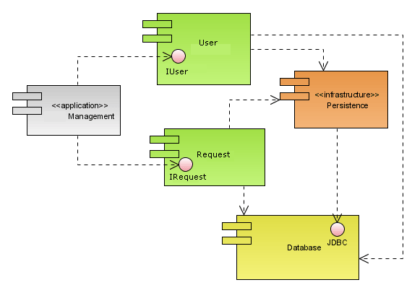
COMPONENT DIAGRAM :

Slide 68
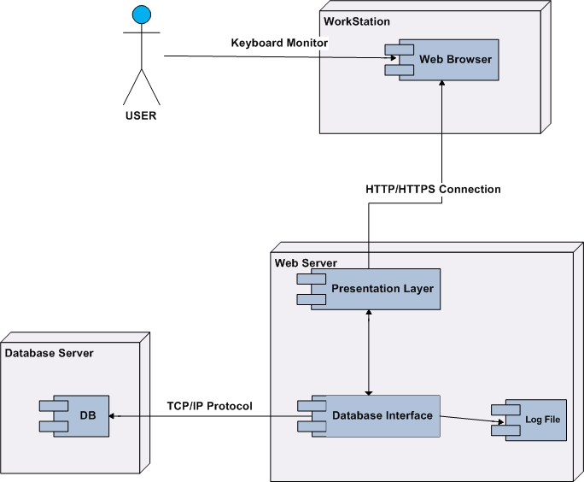
DEPLOYMENT DIAGRAM:

